Slide 1



Desafio2
View in Power BI
Last data refresh:
28/03/2022 12:45:28 UTC
Downloaded at:
28/03/2022 13:12:52 UTC

Slide 2
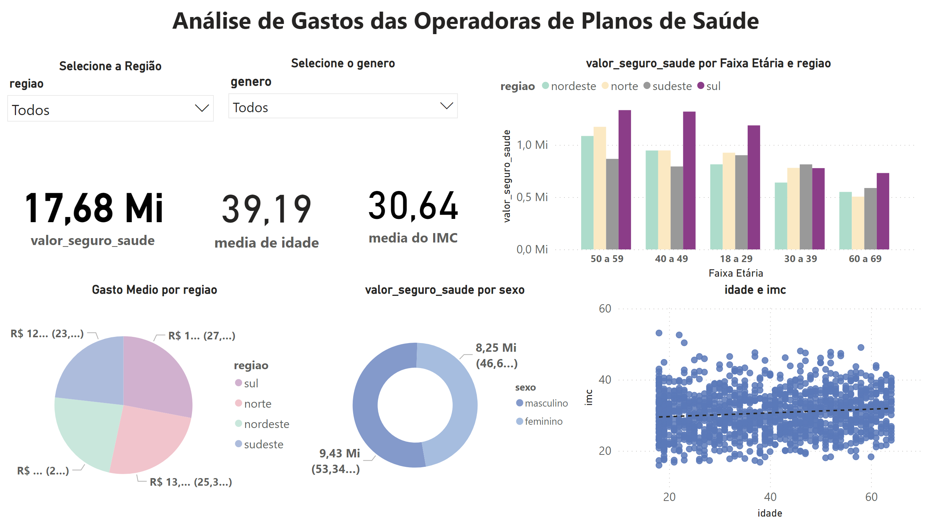
Analise de Gastos
Notes:
card
No alt text provided
textbox
No alt text provided
card
No alt text provided
pieChart
No alt text provided
clusteredColumnChart
No alt text provided
scatterChart
No alt text provided
donutChart
No alt text provided
card
No alt text provided
Selecione o genero
No alt text provided
Selecione a Região
No alt text provided

